Slide 1

Introduction to Operating Systems CS/COE 1550
Spring 2020-2021
Sherif Khattab
ksm73@pitt.edu
(Some slides are from Silberschatz, Galvin and Gagne ©2013)

Slide 2
Announcements
Homework 1 is due this Friday at 11:59 pm
Recitations started last week
Please watch the video
Tophat questions assigned as homework
Lab 1 is due
Don’t forget to git add
Using GitHub Classroom

Slide 3
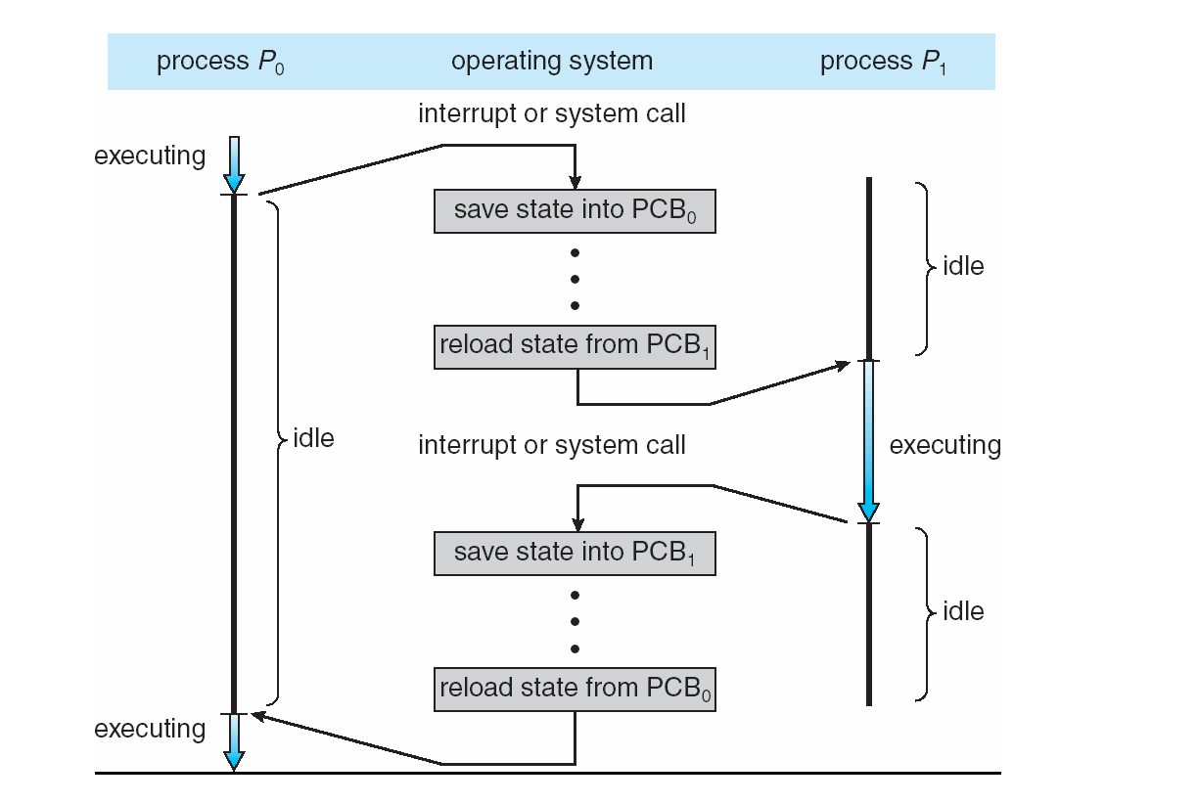
Last lecture …
Context Switching

Slide 4
Muddiest points
I feel I need to review the context switching slide (and try to retrace the c code provided for practice)
Context switching
Understanding the use of the context switching and the uses and implementation.
I'll want to review the code again off-line, but I appreciate taking a look at it in lecture. It's helpful after theory.
What causes a context switch to occur
syscalls
I feel I need to review the context switching slide (and try to retrace the c code provided for practice)
Simple OS, microkernel OS, and monolithic OS
Microkernels versus monolithic kernels – why and how?
The benefits and drawbacks when comparing microkernel and monolithic OS structures
What are the significant points to remember about the simple OS structure vs. the microkernel OS structure?
The concept of the process control block
PCB was interesting in how it stores information on all the processes the system is running
After watching some other sources about context switching, everything seems clear to me so far.
How does the scheduler determine the amount of CPU time a process gets? I would guess priority makes a difference but does each process get less time if there are more PCBs?

Slide 5
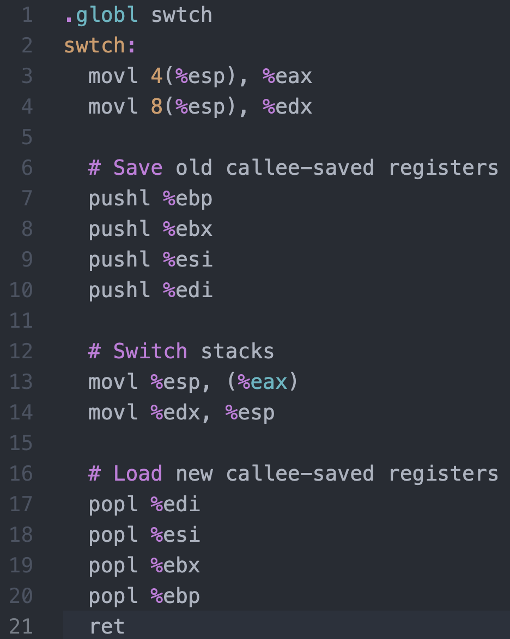




Context Switching in Xv6
%eax
%edx
context
PCB of Process${ P}_{0}$
Return address
%esp
%eip
Stack of Process${ P}_{0}$
Return address
Return address
CPU
context
PCB of Process${ P}_{1}$
Stack of Process${ P}_{1}$
Memory

Slide 6
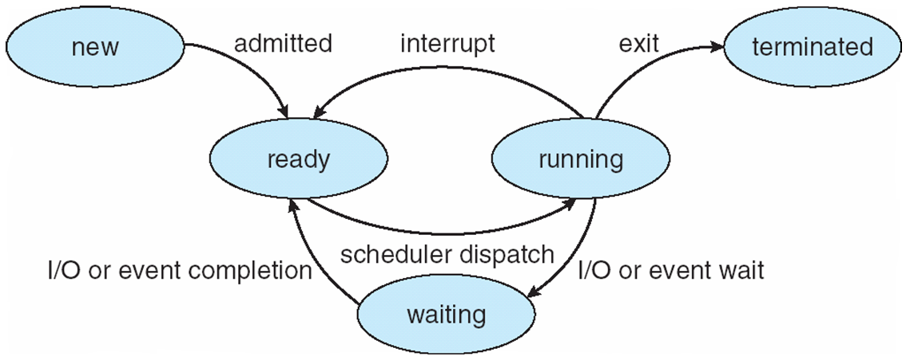
Process Lifecycle

Slide 7
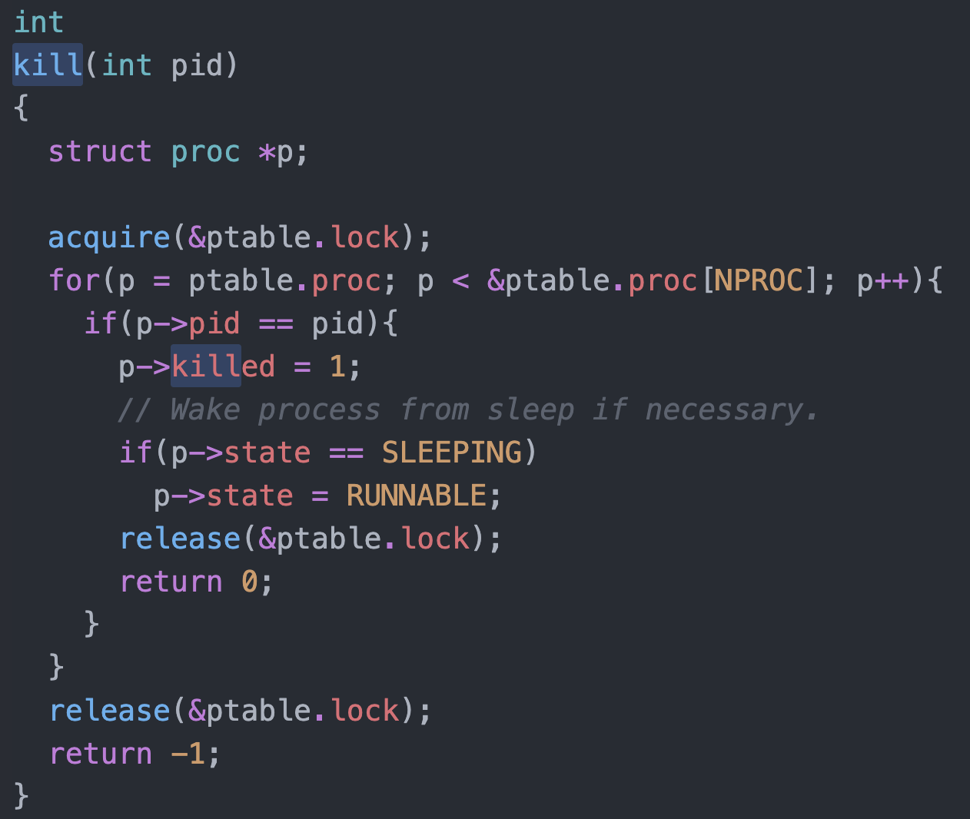
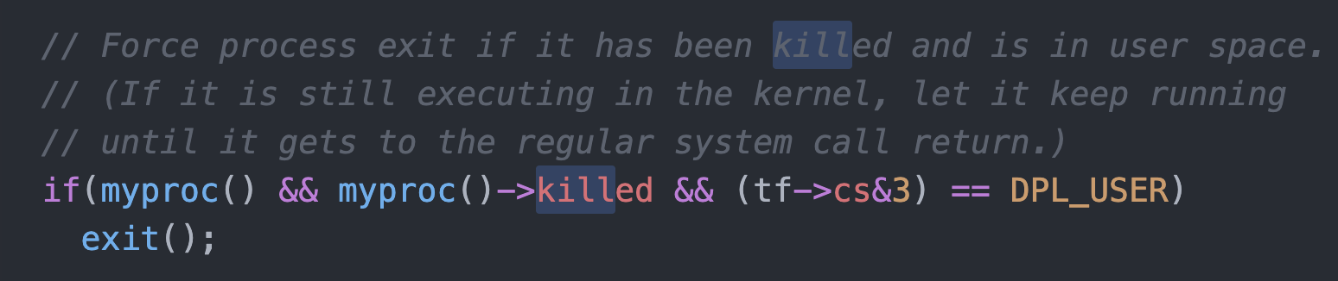
Killing a waiting process

Slide 8
Process Scheduling
Maximize CPU use, quickly switch processes onto CPU for time sharing
Process scheduler selects among available processes for next execution on CPU
Maintains scheduling queues of processes
Job queue – set of all processes in the system
Ready queue – set of all processes residing in main memory, ready and waiting to execute
Device queues – set of processes waiting for an I/O device
Processes migrate among the various queues

Slide 9
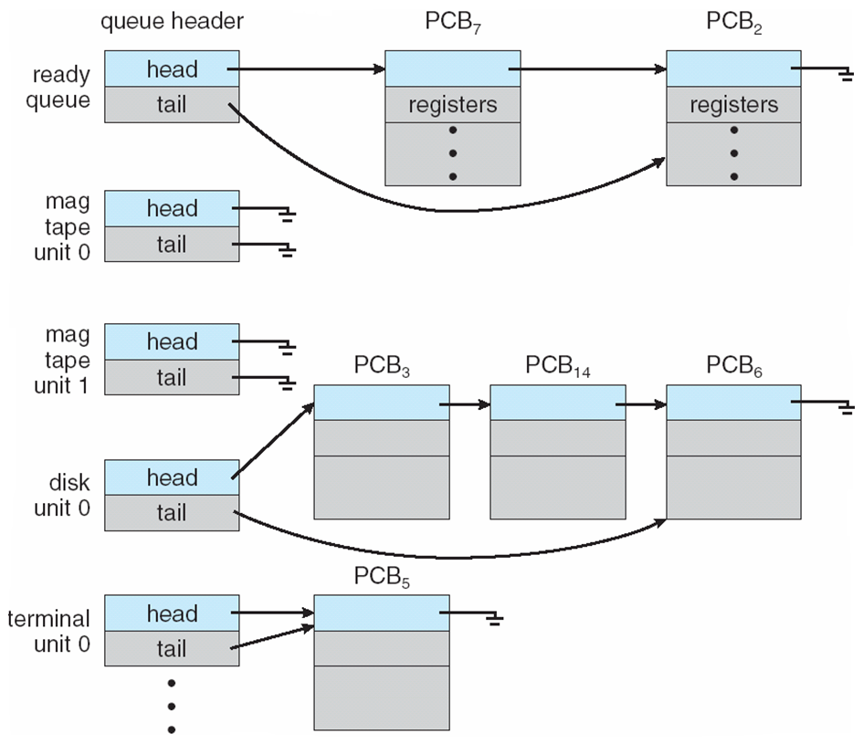
Ready Queue And Various I/O Device Queues

Slide 10
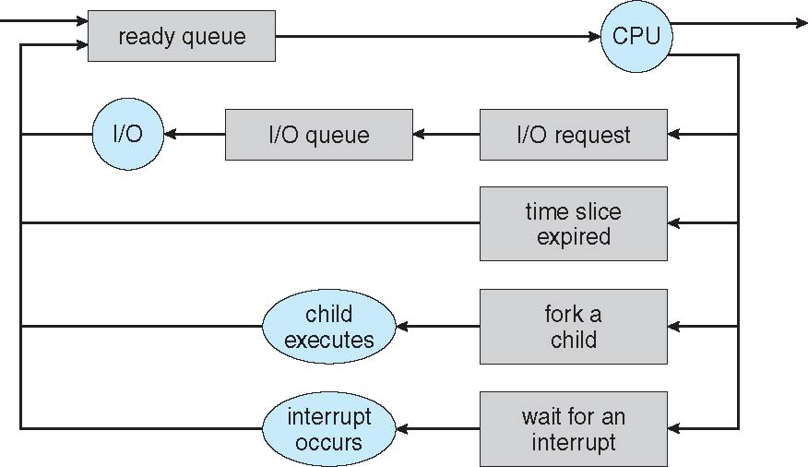
Representation of Process Scheduling
Queueing diagram represents queues, resources, flows

Slide 11
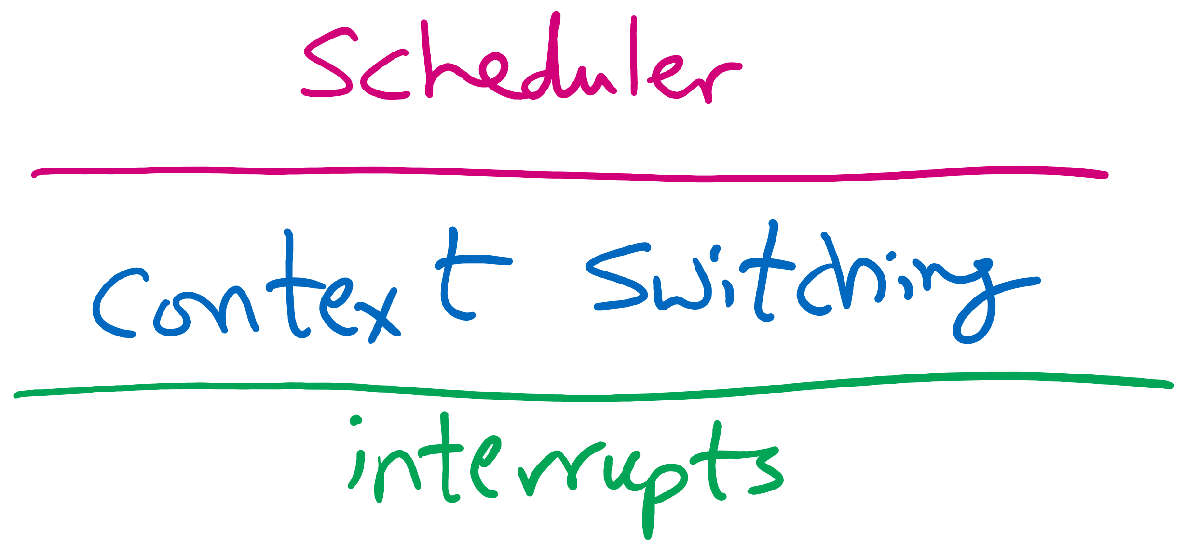
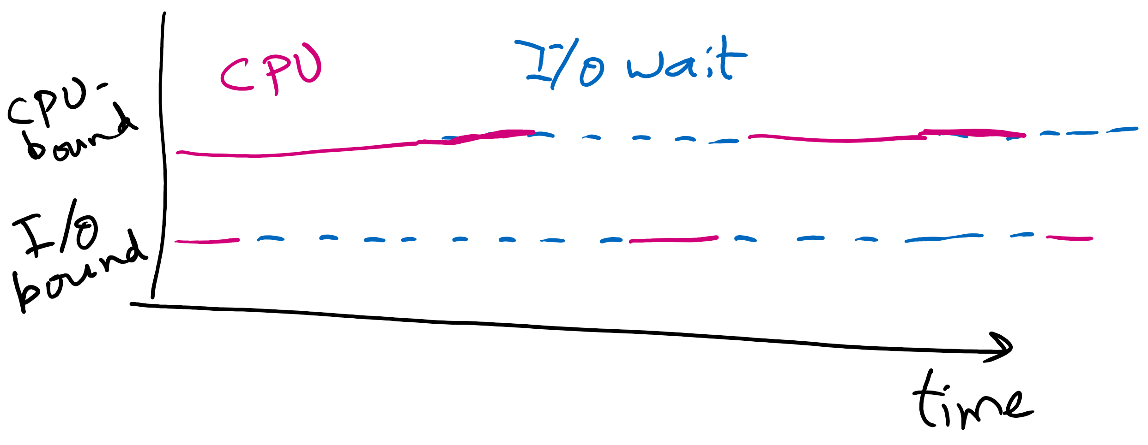
Schedulers
Short-term scheduler (or CPU scheduler) – selects which process should be executed next and allocates CPU
invoked frequently (milliseconds) ⇒ (must be fast)
Long-term scheduler (or job scheduler) – selects which processes should be brought into the ready queue
invoked infrequently (seconds, minutes) ⇒ (may be slow)
controls the degree of multiprogramming
Processes can be described as either:
I/O-bound process – spends more time doing I/O than computations, many short CPU bursts
CPU-bound process – spends more time doing computations; few very long CPU bursts
Long-term scheduler strives for good process mix

Slide 12
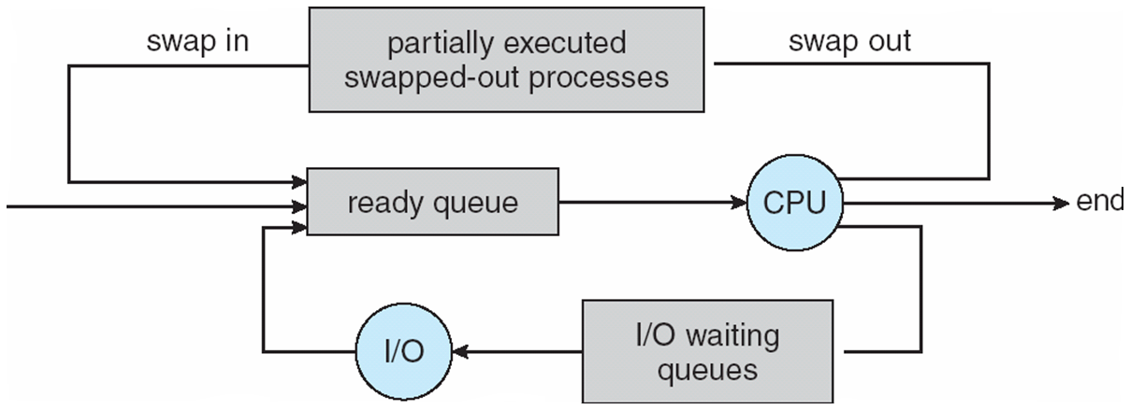
Addition of Medium Term Scheduling
Medium-term scheduler can be added if degree of multiple programming needs to decrease
Remove process from memory, store on disk, bring back in from disk to continue execution: swapping

Slide 13
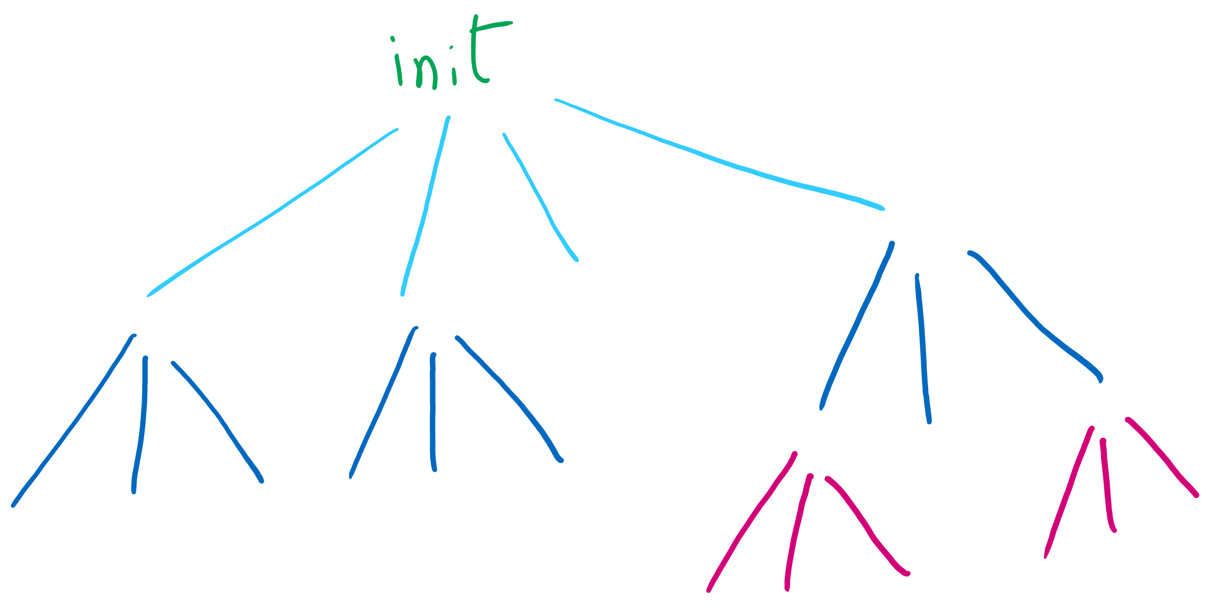
Process Creation
Parent process creates children processes, which, in turn create other processes, forming a tree of processes
Generally, process identified and managed via a process identifier (pid)
Resource sharing options
Parent and children share all resources
Children share subset of parent’s resources
Parent and child share no resources
Execution options
Parent and children execute concurrently
Parent waits until children terminate

Slide 14
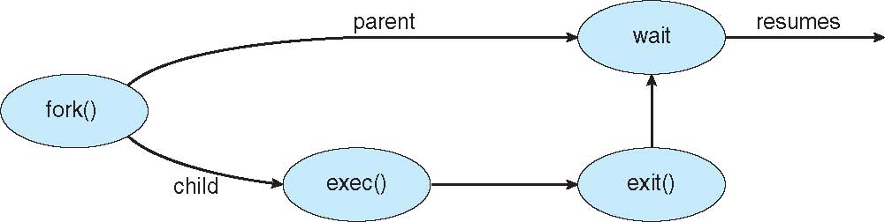
Process Creation (Cont.)
Address space
Child duplicate of parent
Child has a program loaded into it
UNIX examples
fork() system call creates new process
exec() system call used after a fork() to replace the process’ memory space with a new program

Slide 15
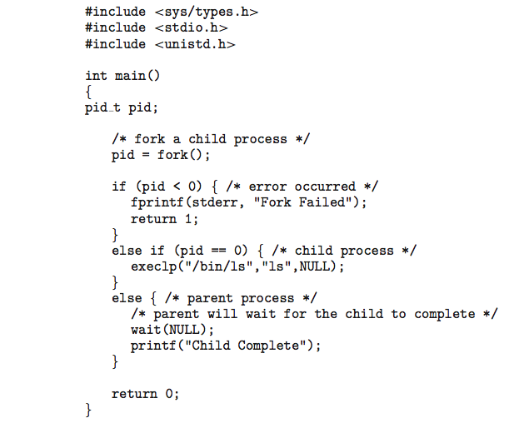
C Program Forking Separate Process

Slide 16
Process Termination
Process executes last statement and then asks the operating system to delete it using the exit() system call.
Returns status data from child to parent (via wait())
Process’ resources are deallocated by operating system
Parent may terminate the execution of children processes using the abort() system call. Some reasons for doing so:
Child has exceeded allocated resources
Task assigned to child is no longer required
The parent is exiting and the operating systems does not allow a child to continue if its parent terminates

Slide 17
Process Termination
Some operating systems do not allow a child to exist if its parent has terminated. If a process terminates, then all its children must also be terminated.
cascading termination. All children, grandchildren, etc. are terminated.
The termination is initiated by the operating system.
The parent process may wait for termination of a child process by using the wait()system call. The call returns status information and the pid of the terminated process
pid = wait(&status);
If no parent waiting (did not invoke wait()) process is a zombie
If parent terminated without invoking wait , process is an orphan

Slide 18
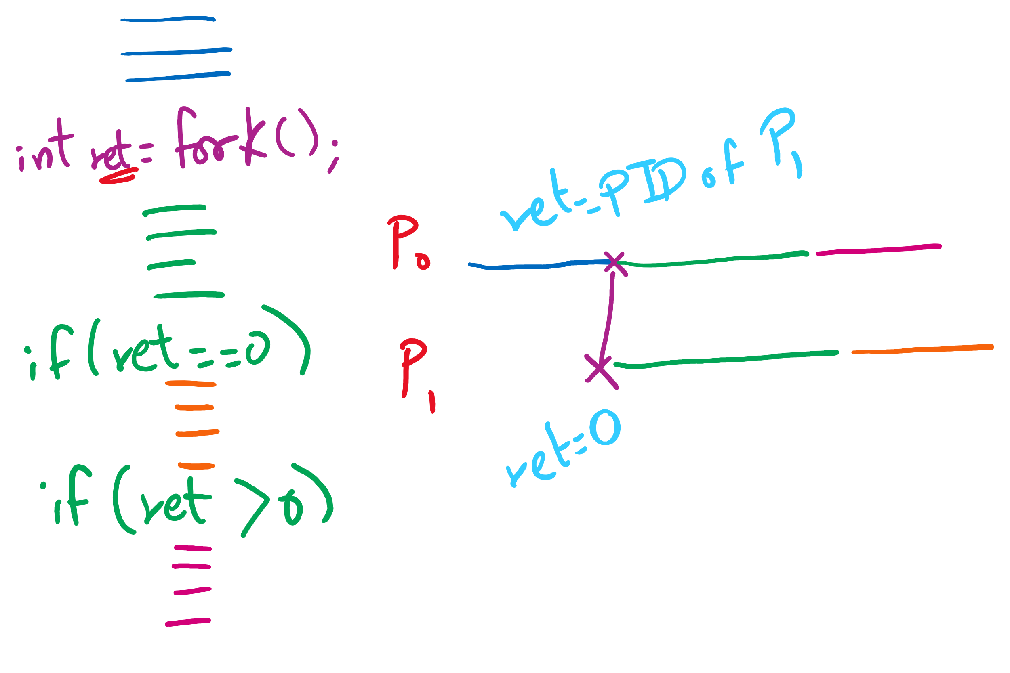
fork() tracing

Slide 19
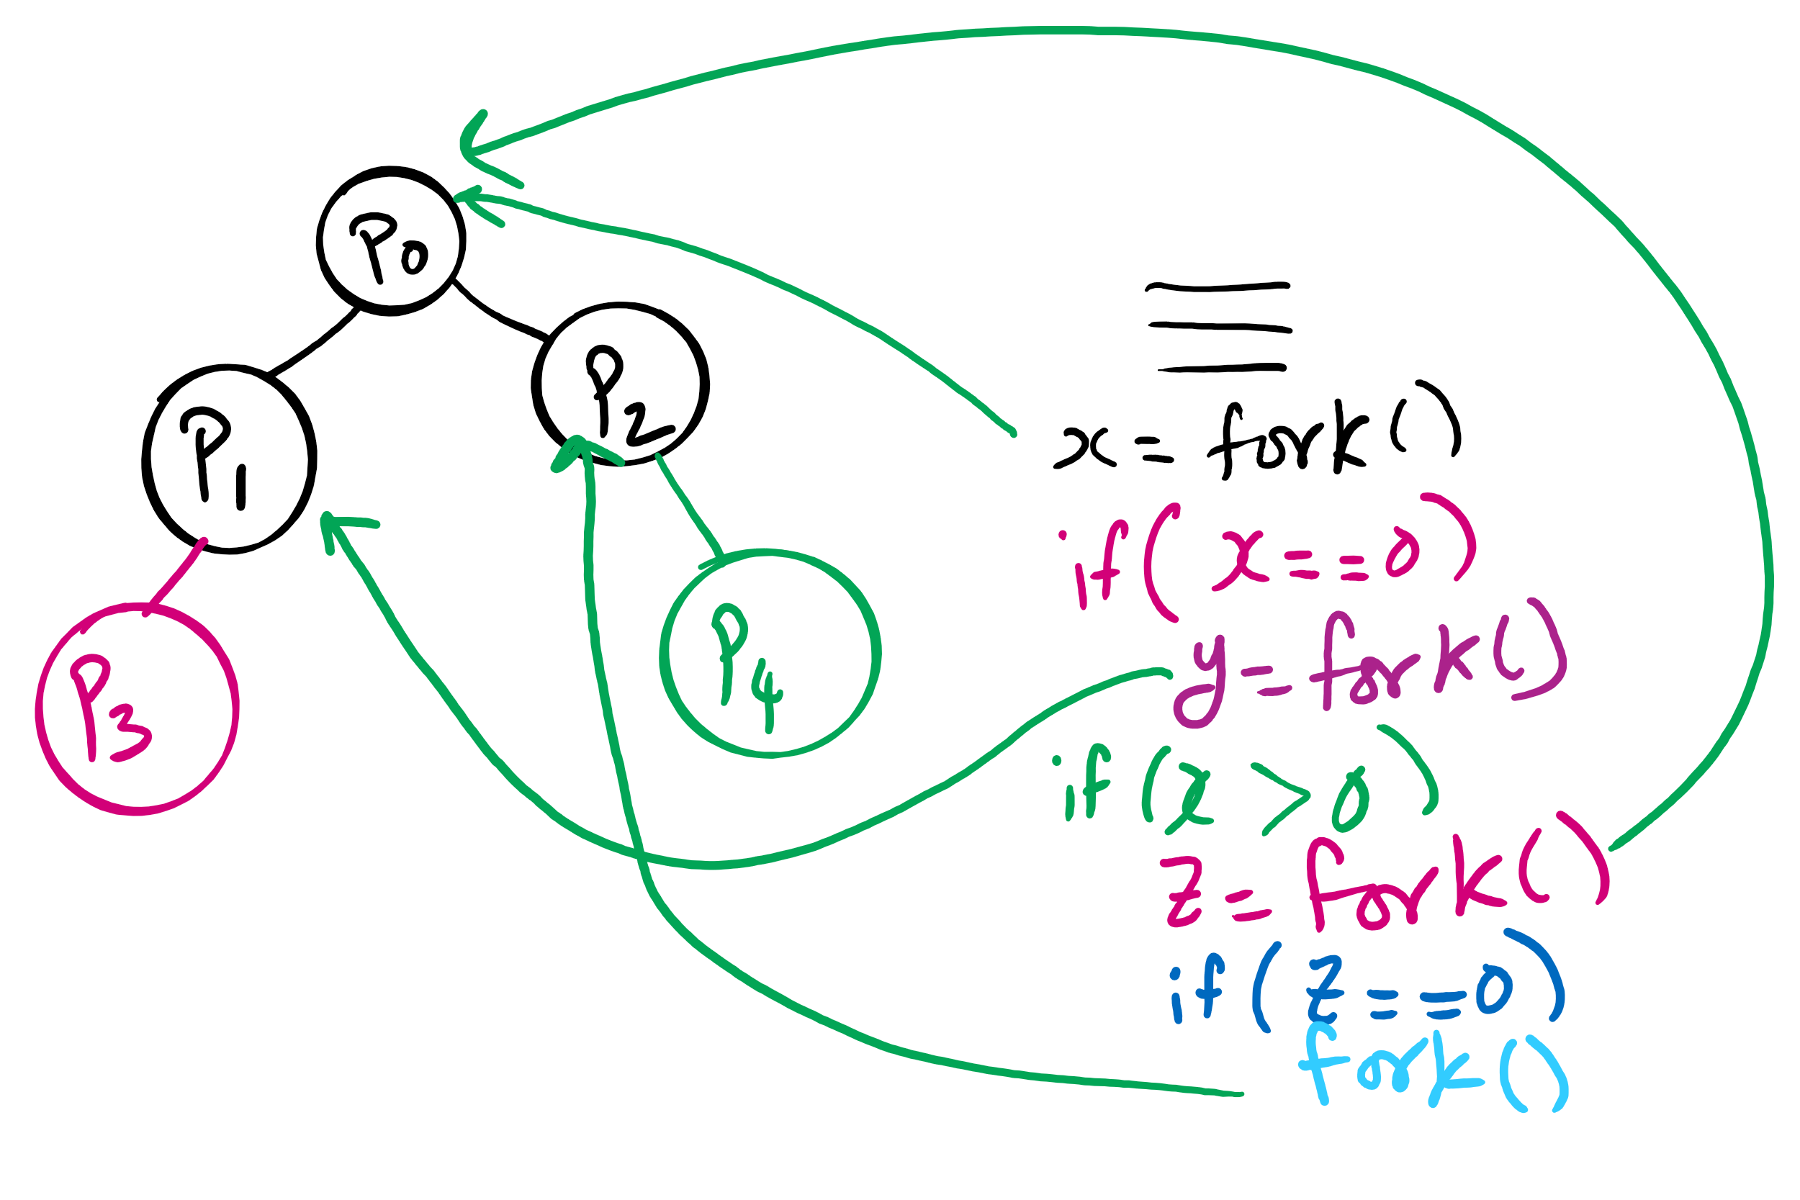
fork()’s of fork()’s

Slide 20
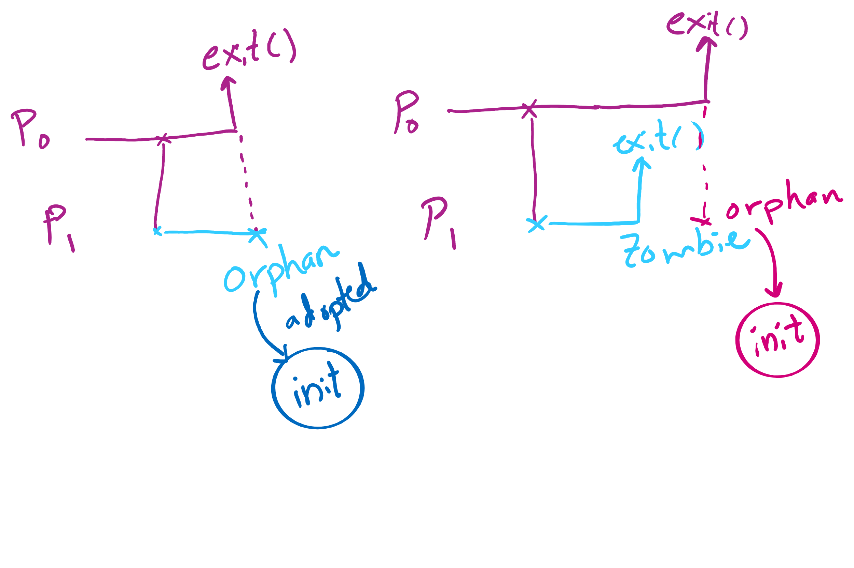
Orphan vs. Zombie Processes

Slide 21
Xv6 Code Walkthrough
Context switching
Calling of the swtch routine
fork()
exit()
wait()

